Slide 1


Setting up a Workspace
Dr Kieran Lewis, Occupational Therapy Manager, Trinity Disability Service
Trinity College Dublin, The University of Dublin

Slide 2
Background
Occupational Therapist for past 20 years in Trinity
  Person, Environment and Occupation
  1:1 approach for UG and PG disabled students
Lead on the TCD Sense Project in Trinity
Have studies as an Undergraduate and PhD student here in Trinity
Trinity College Dublin, The University of Dublin

Slide 3
Workspaces
Library (Assigned space or general library spaces)
Assigned Space in department or elsewhere
Lab based
Fieldwork
Teaching Spaces
Group Spaces
Home
Other spaces – social spaces, outdoor spaces, cafes etc
Mix of spaces – to activity or to time of day
Trinity College Dublin, The University of Dublin

Slide 4
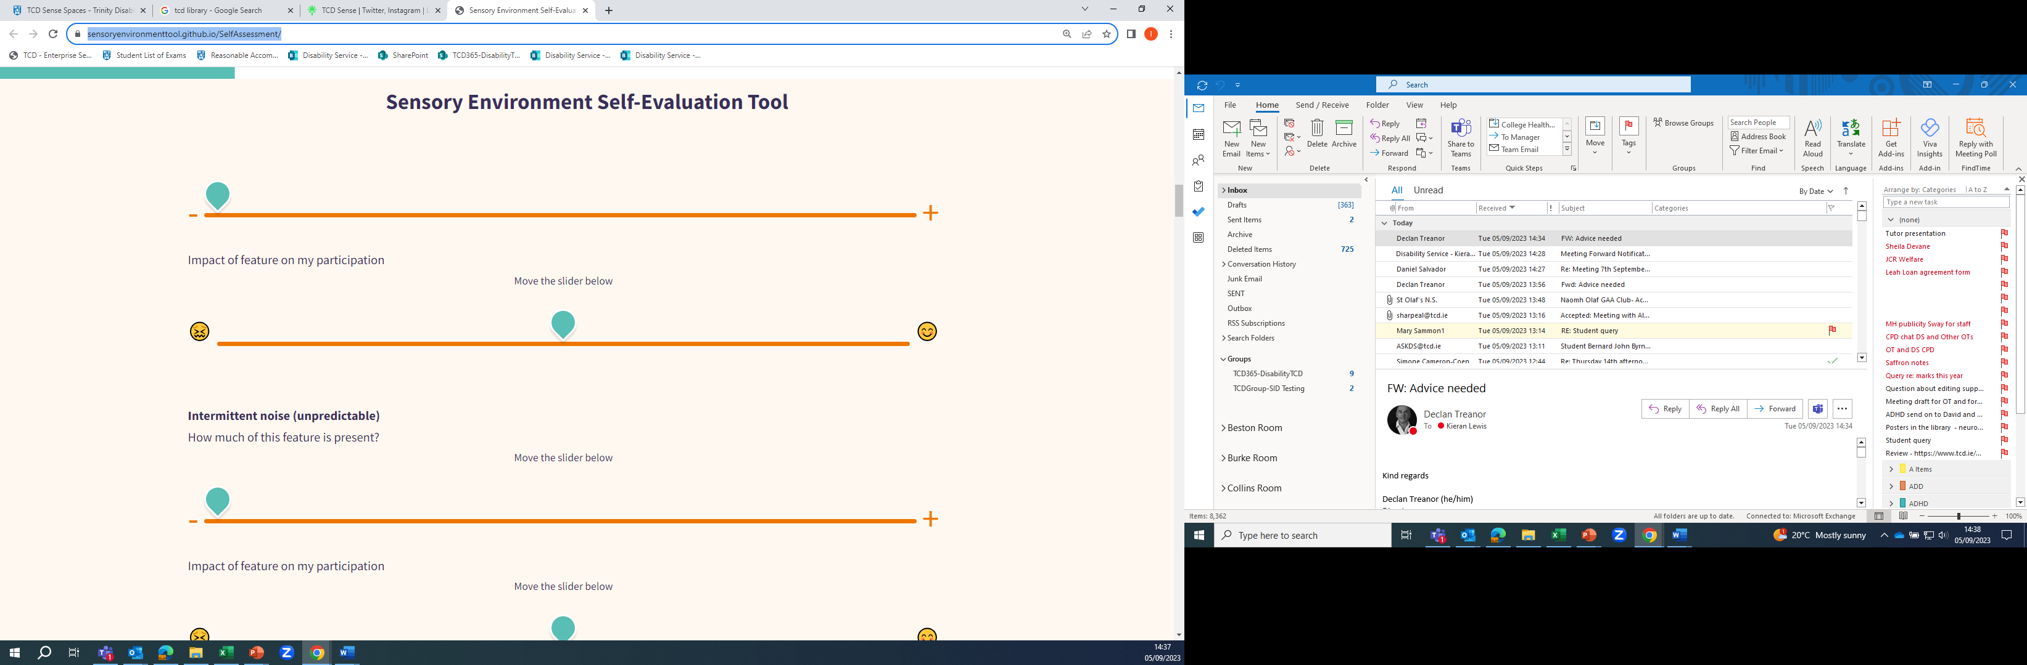
Meeting your Needs & Preferences
How do I work best? (Visual, Discussion, Movement, Reading, Aural)
Where do I work best? – what are the physical & sensory characteristics of these
Does this change over the course of a day / week?
Is variety important?
https://sensoryenvironmenttool.github.io/SelfAssessment/
Trinity College Dublin, The University of Dublin

Slide 5
Setting up Your Environment
Physical environment (including physical access, sensory preferences) – e.g. workspace, noise, light, clutter etc.
Virtual environment – e.g. managing distractions such as email, news, social media.
Social environment – e.g. managing interactions with other students, our family, housemates, friends, lecturers etc.
Trinity College Dublin, The University of Dublin

Slide 6
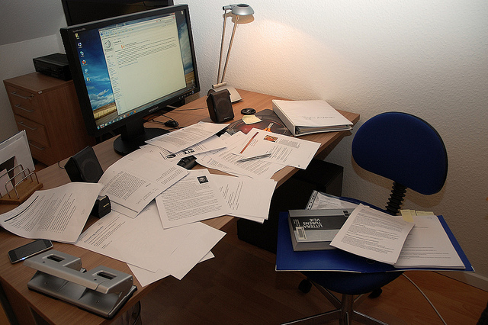
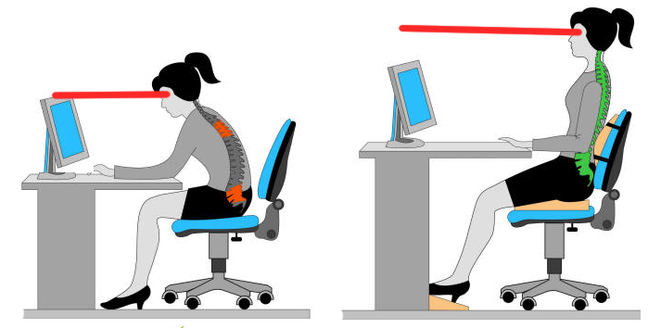
Setting up Your Environment
Table desk – set up
Ergonomics - https://youtu.be/KhuJWxPXShI
iProtectU Compliance (tcd.ie)
Tidiness of your workspace
Trinity College Dublin, The University of Dublin
Notes:
Health and Safety when working remotely
Our environment, equipment and space when working from home must be suitable, in line with Health & Safety legislation. To support people in assessing this suitability assessment can be completed through Trinity College Health, Safety and Environmental Management system called "iProtectu".

Slide 7
Help is there!
Occupational Therapy consultation - https://www.tcd.ie/disability/services/sensory-support/
Available to all students – especially PG students using same spaces throughout time in Trinity
College Health – Physiotherapist
Trinity College Dublin, The University of Dublin

Slide 8
Library
Library Floorplans - https://wagnerguide.com/c/trinitycollegedublin/berkeleylibraryold?mapfile=1758&menuid=258&searchbar=true&menu=true&entitymenus=true
Sensory Spaces - https://www.tcd.ie/library/using-library/disabilities.php
Trinity College Dublin, The University of Dublin

Slide 9
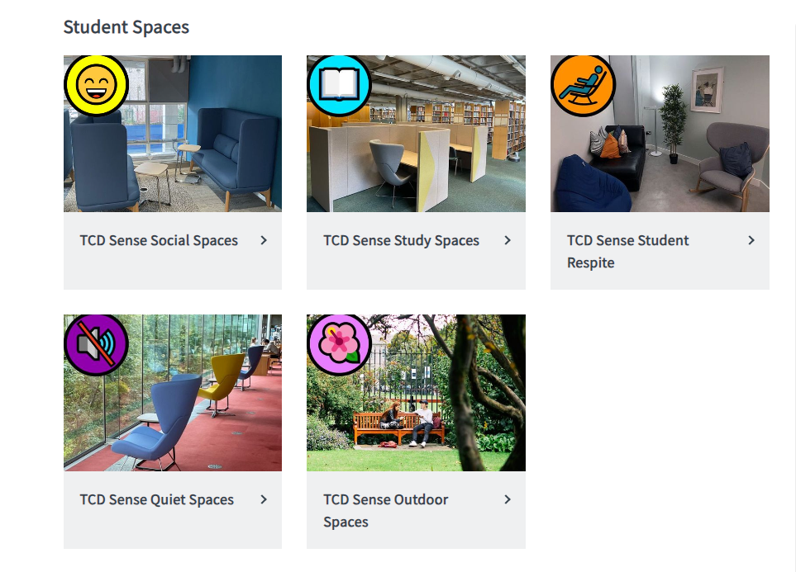
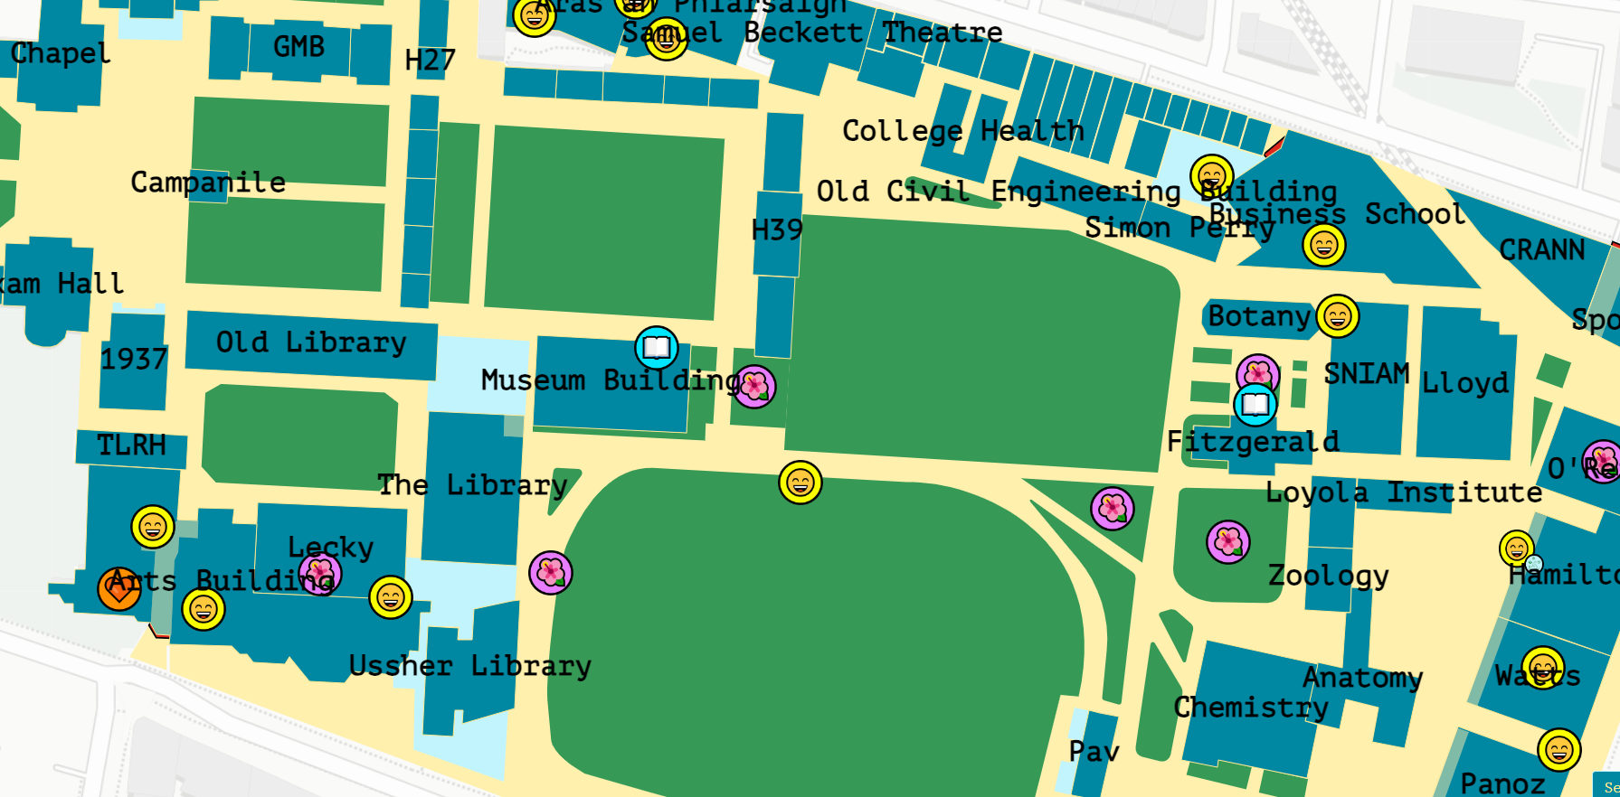
Sensory Environments
TCD Sense Spaces
Sensory Map - TCD Sense Map
Trinity College Dublin, The University of Dublin

Slide 10
Final Advice
Suit your needs and preferences – physical & sensory
Try different set ups
Don’t be tied to one type of space
Build changes of environment into your routine
Divide workspace from relaxation / social space where possible
Come to talk through it
Trinity College Dublin, The University of Dublin

